Slide 1



Final Presentation
Team SIX
Andrei Osypov, Larkin Spires, Ulvi Zamanbayov, Joe McNease
Maitri Erwin, Ed Marotta, Brad Wallet, Rekha Patel
SEAM AI Applied Geoscience GPU Hackathon: March 22 - April 12

Slide 2









PostStack Team SIX
Team SIX is a collaboration among students, early career professionals, industry and academic mentors, and Xrathus, Inc.
PARTICIPANTS
LARKIN SPIRES
Student (PhD)
Geophysicist working in Data Science
Houston, USA
ANDREI OSYPOV
Developer
Product Design Lead at Xrathus
Houston, USA
ULVI ZAMANBAYOV
Early Career
Geophysicist working in Data Science
Baku, Azerbaijan
JOE MCNEASE
Student (BS)
Geophysicist working in Data Science
Houston, USA
MENTORS
BRADLEY WALLET
Domain
Computational Geoscientist at Aramco Americas
Houston, USA
MAITRI ERWIN
Domain
Energy Digital Transformation at Microsoft Azure
Houston, USA
ED MAROTTA
Data Scientist
Principal at Seera Labs, Adjunct Professor UH
Houston, USA
REKHA PATEL
Sponsor
President & Founder, Xrathus Inc.
Houston, USA

Slide 3
PROBLEM STATEMENT
PostStack Team SIX chose the Parihaka data challenge to
Investigate data augmentation via seismic attributes and transformation to enhance ML workflows in the post-stack space
Develop more accurate and efficient machine learning algorithms for seismic facies and geologic feature identification
Explore 3D Unet for sequence boundary and facies identification
Starting assumptions
Training data set: That facies were distinct enough to easily separate/identify
Test data set: Similarity to training data set, especially where training data is adjacent to test data
Number of facies: That teams can work on six- and/or sixteen-facies data sets

Slide 4
EVOLUTION AND STRATEGY
Team Goal
Learn to code in a multidisciplinary group; apply machine learning techniques to high-quality seismic data
Initial strategy
Explore multiple methods for facies and boundary detection, i.e., use many and different seismic attributes and post-processing techniques on results
Change in strategy given time and compute
Seismic facies identification
Select seismic attributes and single 3D Unet architecture
Existing Work
Built on deprecated attributes library
Experiment Results
Pre-processing details: Augmentation and seismic attributes as enhanced input
Performance details: Increased neural network depth and available data set size

Slide 5
FINAL SOLUTION
Walk-Through:
Augmentation | Attributes – Larkin Spires
Augmentation | Transformation – Ulvi Zamanbayov
3D Unet – Andrei Osypov
Results provided:
Accuracy achieved
Performance Numbers: (GPU/CPU Details) training times

Slide 6
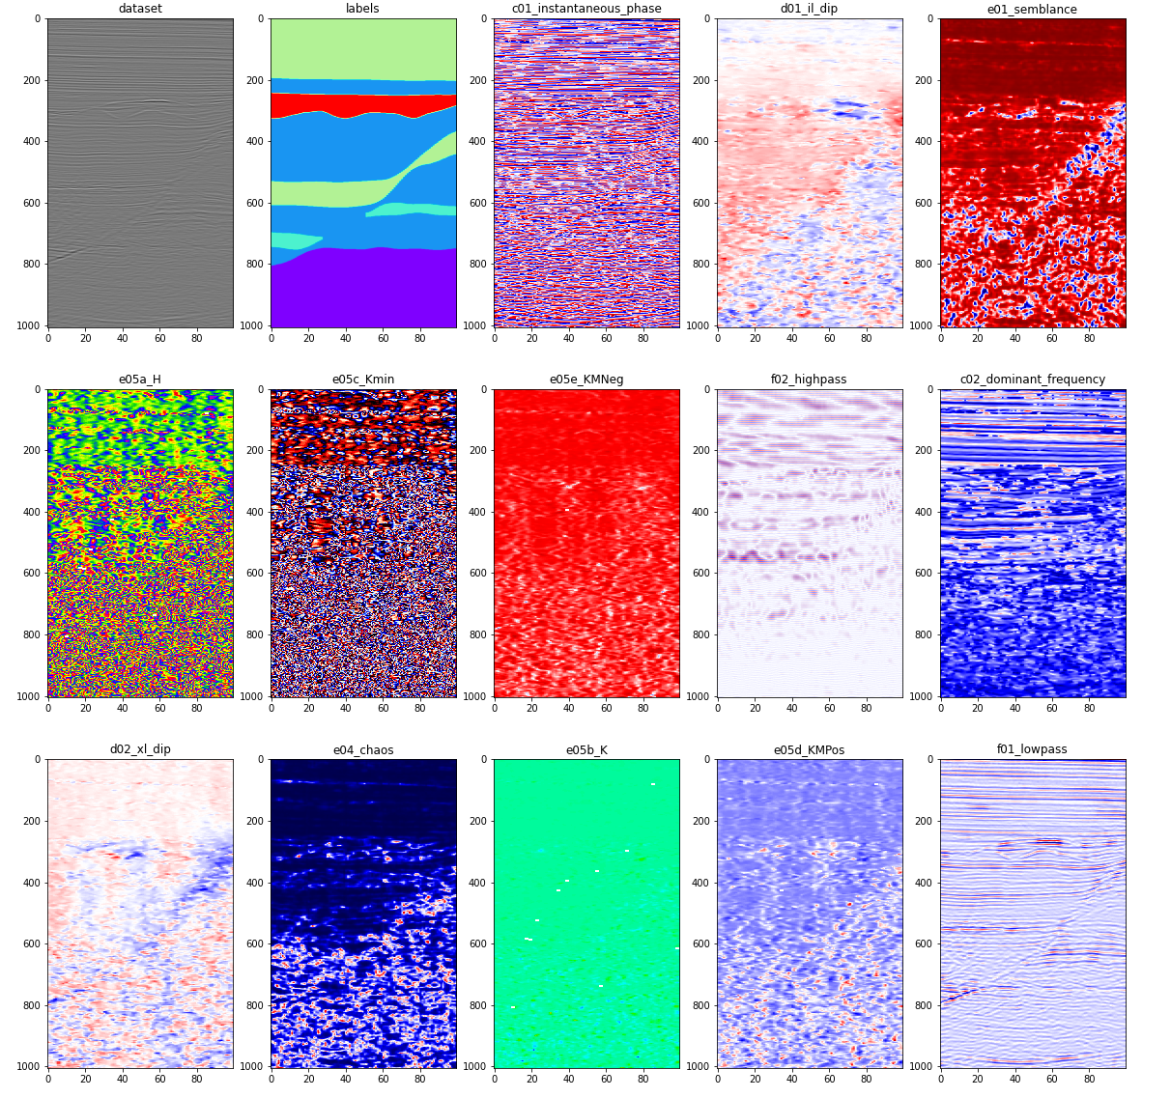
Augmentation using Attributes
Tested the effects of using seismic attributes as channels in the neural network.
Built on deprecated attributes library
Result: Semblance, RMS, and Instantaneous Phase had highest accuracies

Slide 7
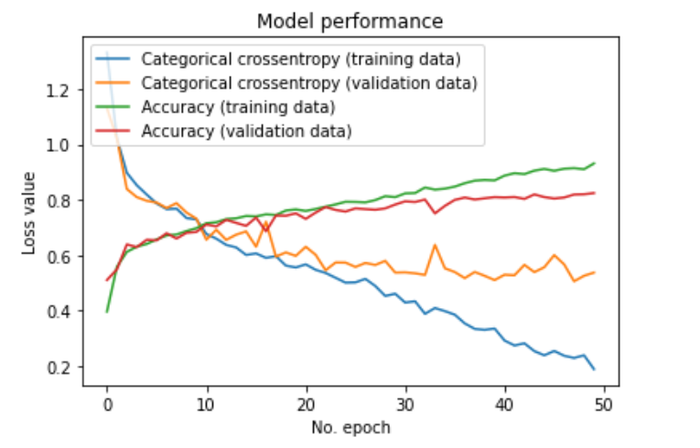
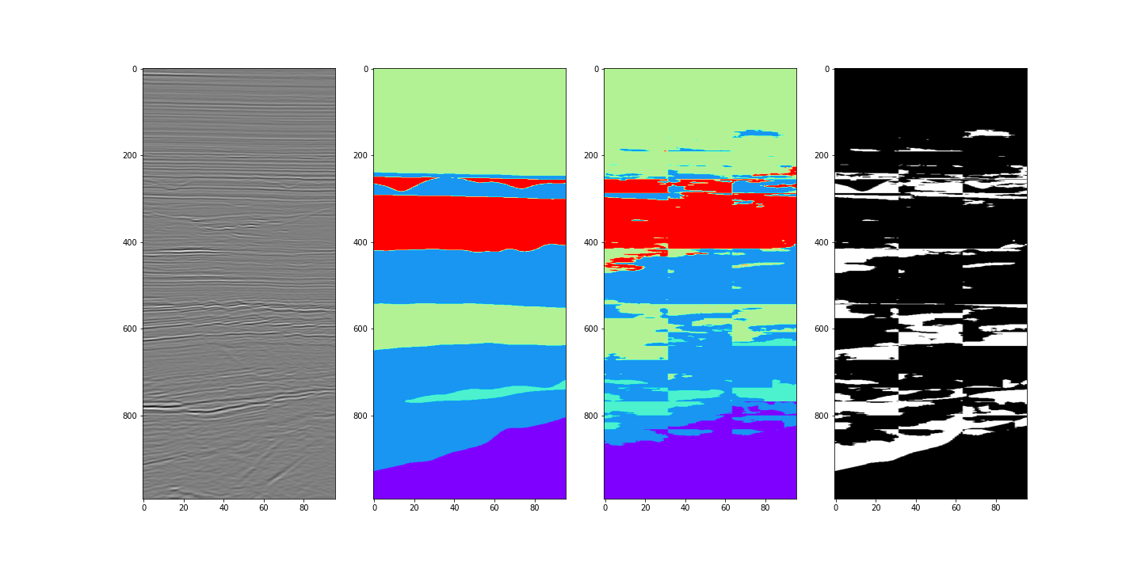
Instantaneous Phase and Depth
3500 boxes
Learning rate 0.0007
Dropout rate 0.3
Notes:
The neural net began overfitting around epoch 35. This set had a very low dropout rate which tends to create overfitting. However, it did capture some of the shallow channels.

Slide 8
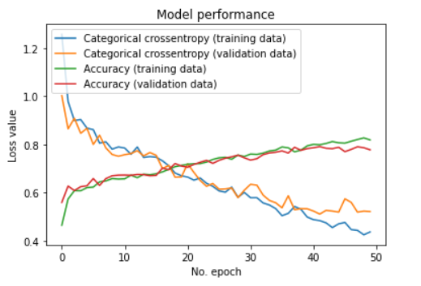
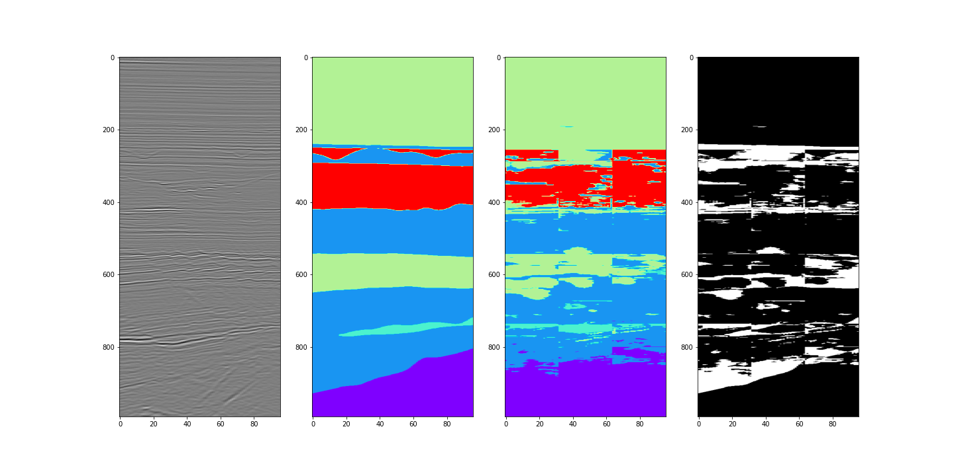
Channels: Instantaneous Phase and Depth
3500 boxes
Learning rate 0.001
Dropout rate 0.6

Slide 9
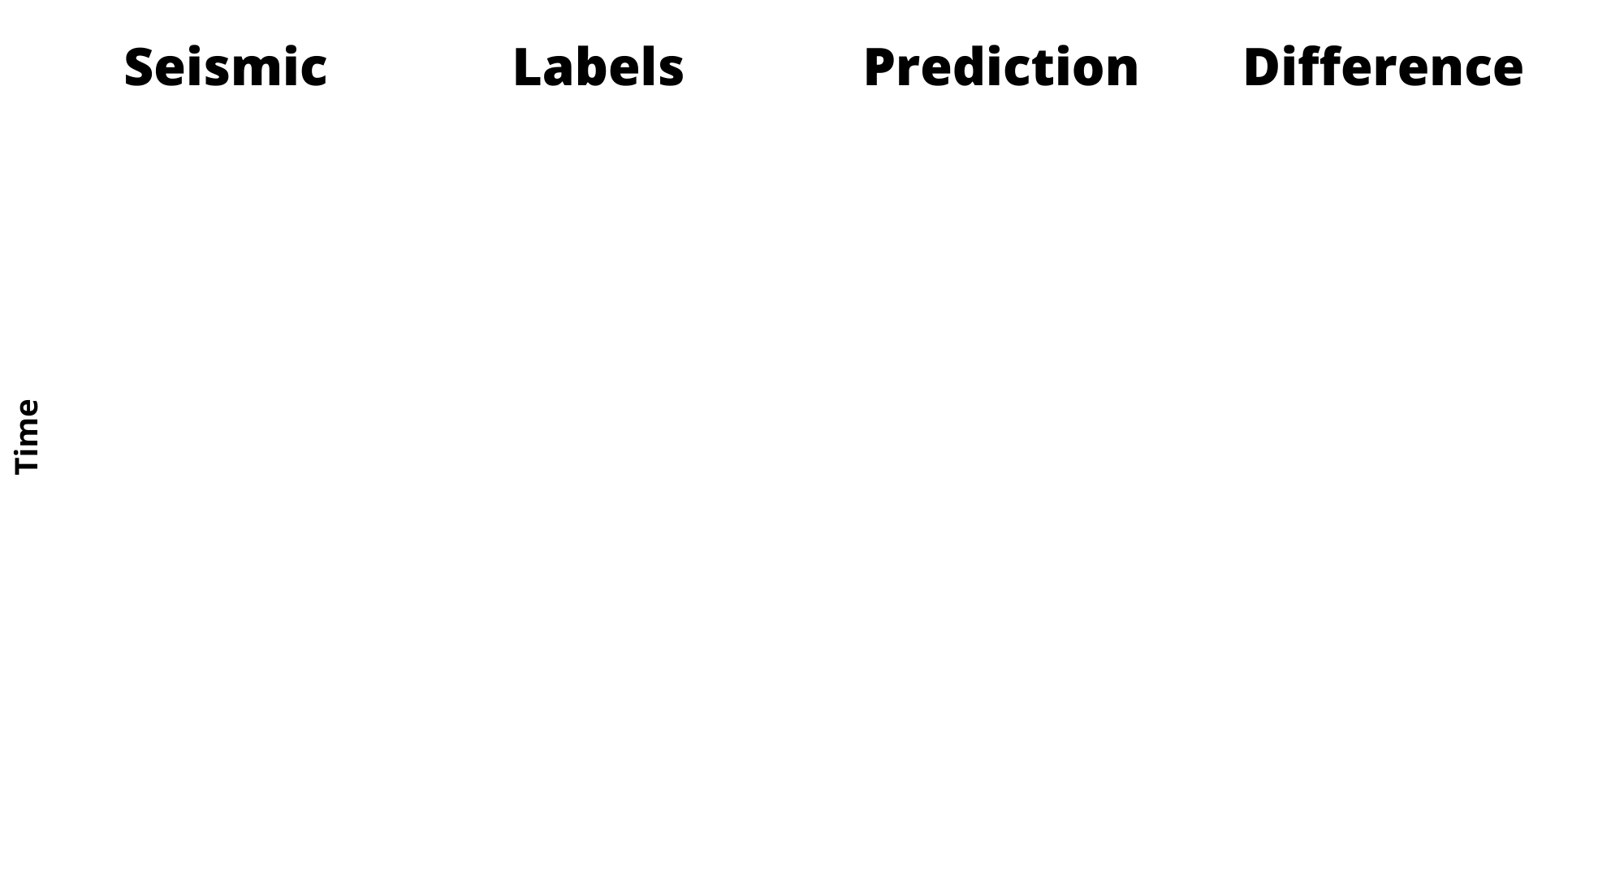
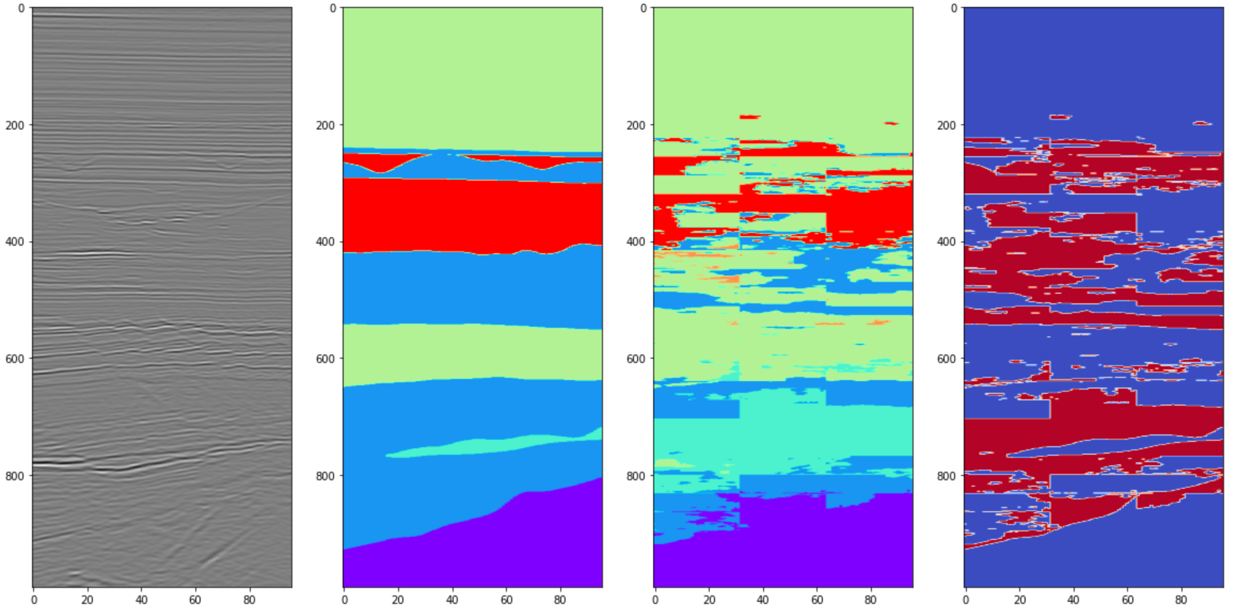
Channels: Depth, Instantaneous Phase, Semblance, RMS
5000 blocks
Interesting observation: Performance is worse than single attributes paired with depth
Proposed causes:
More training blocks would be needed for the algorithm to learn the relationships between the attributes, or
There are too many facies labeled as the same and only some properties are captured in the test/train split.

Slide 10
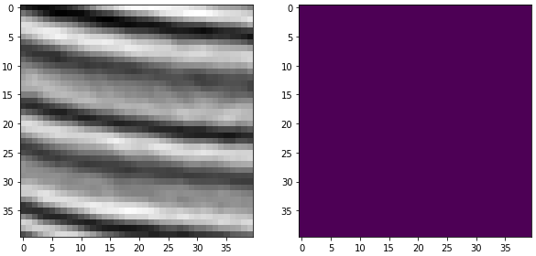
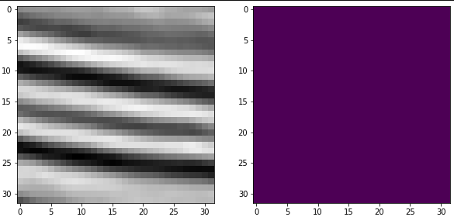
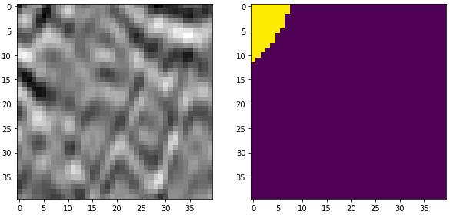
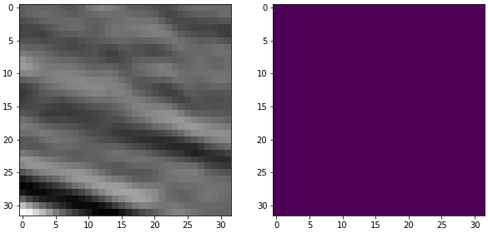
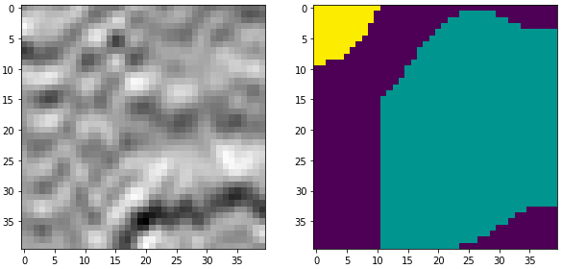
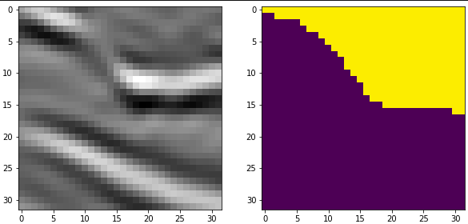
Augmentation using Transformations
1, Crop out sub-volumes in 40x40x40 cubes (225 samples)
2. Randomly feed them into different categories with each doing a different combination of:
Transpose
Rotate by 90/180/270 degrees*
3. Crop to 32x32x32 (optimal dimensions for the U-net algorithm)
* It is important to keep these transformations in the horizontal plane (x-y axis), to perserve the geological sense of the data.

Slide 11
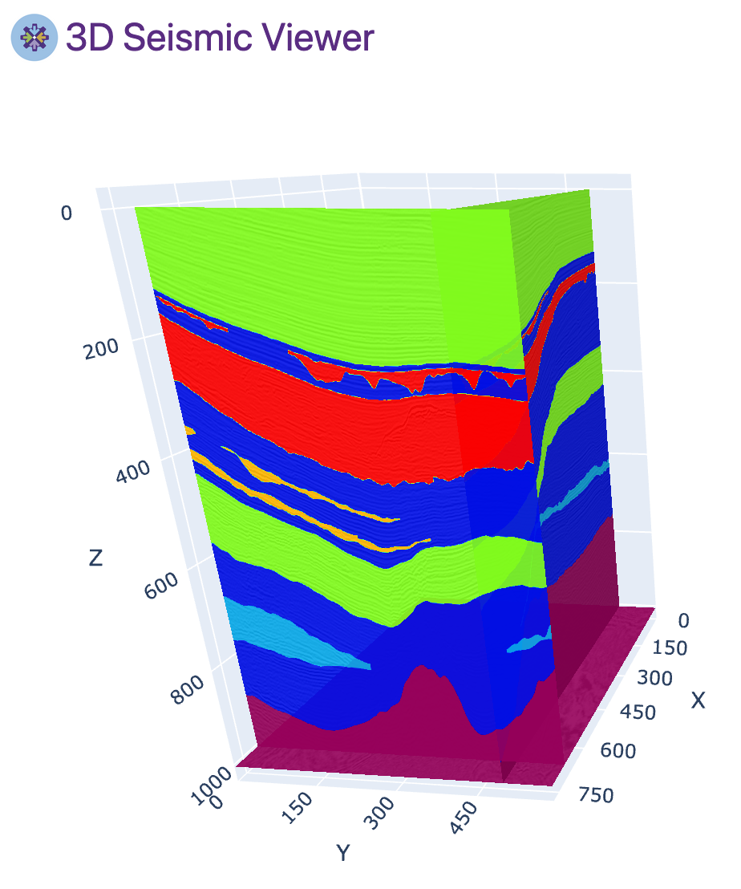
Unet Results
Seismic Section
Original Labels
Location of seismic section on training data

Slide 12
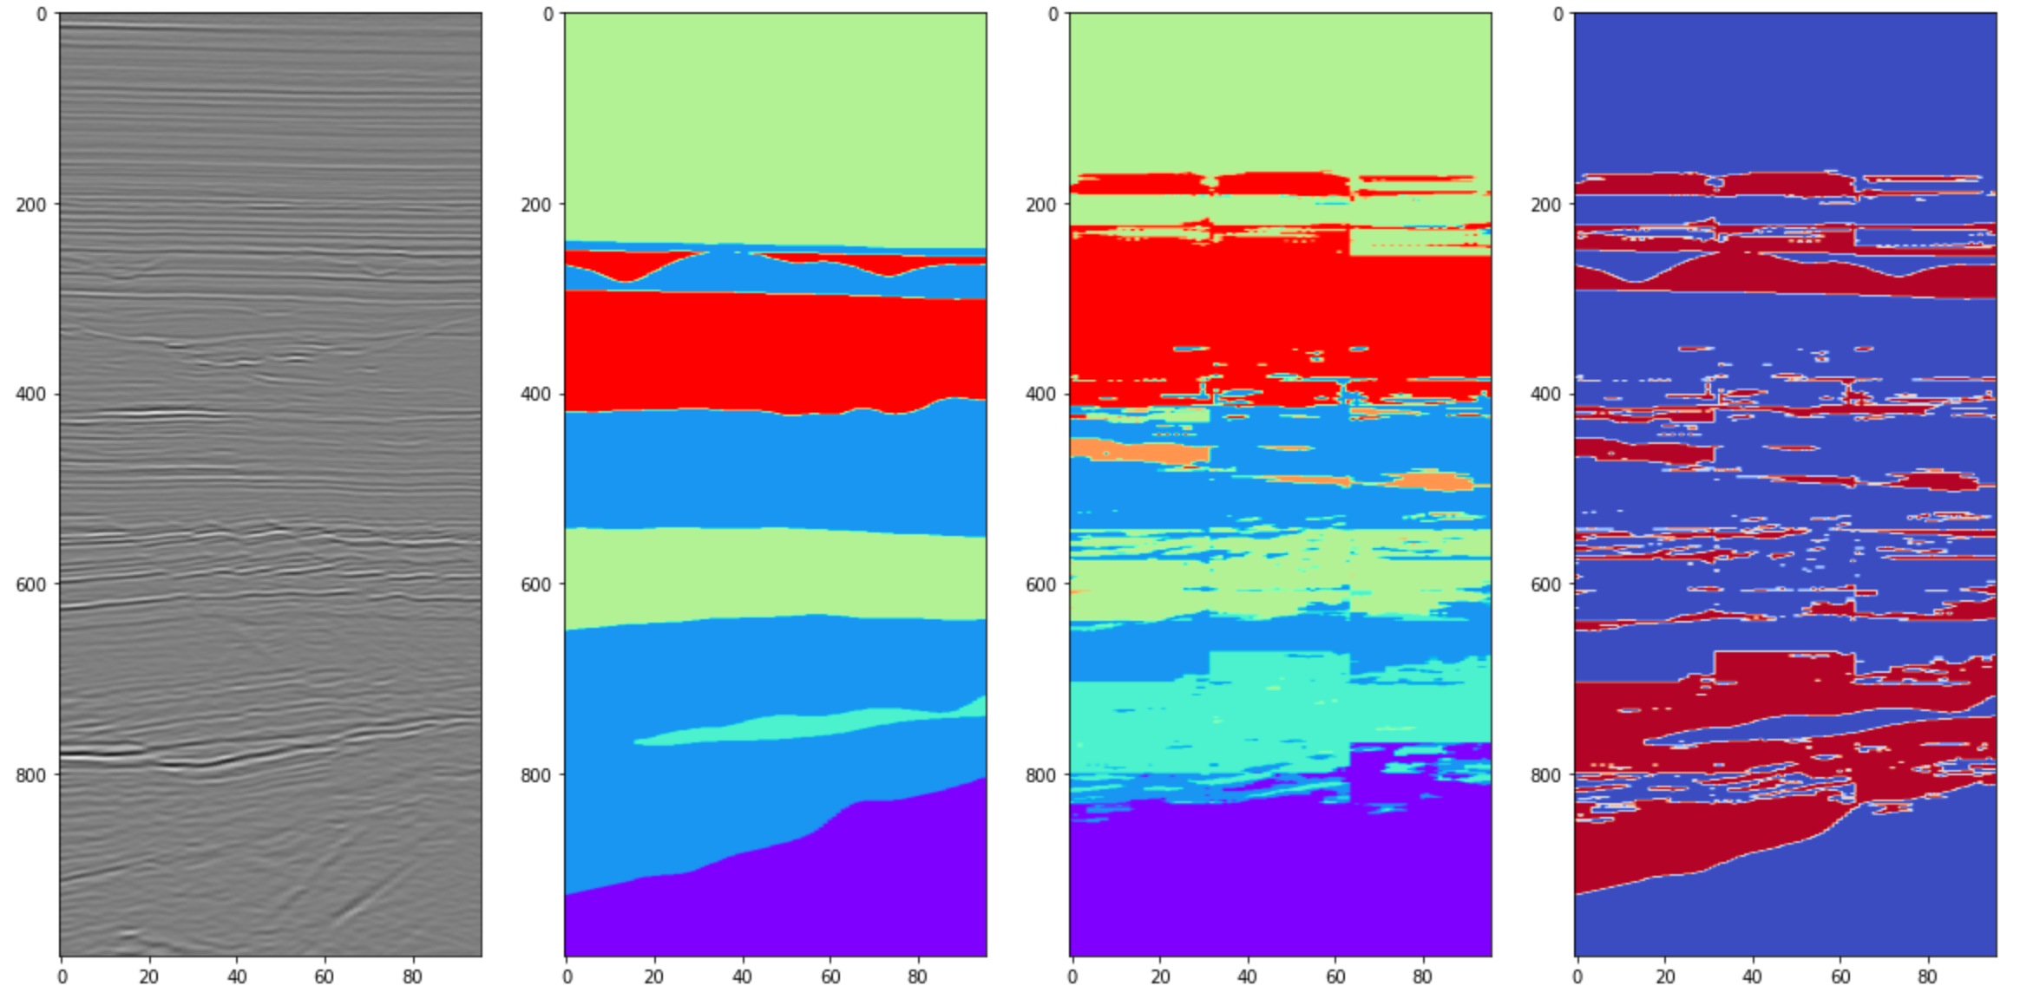
Unet: No Augmentation
Accuracy: 68.7% | 12 min end-to-end on 3GPUs
Specifics:
3 GPUs – 5000 boxes, 1 attributes, 30 epochs
Data Loaded +3m = 3m
Data Prep & Model Compile +3m = 6m
Model Trained +4m = 10m
Predictions Generated +2m = 12m

Slide 13
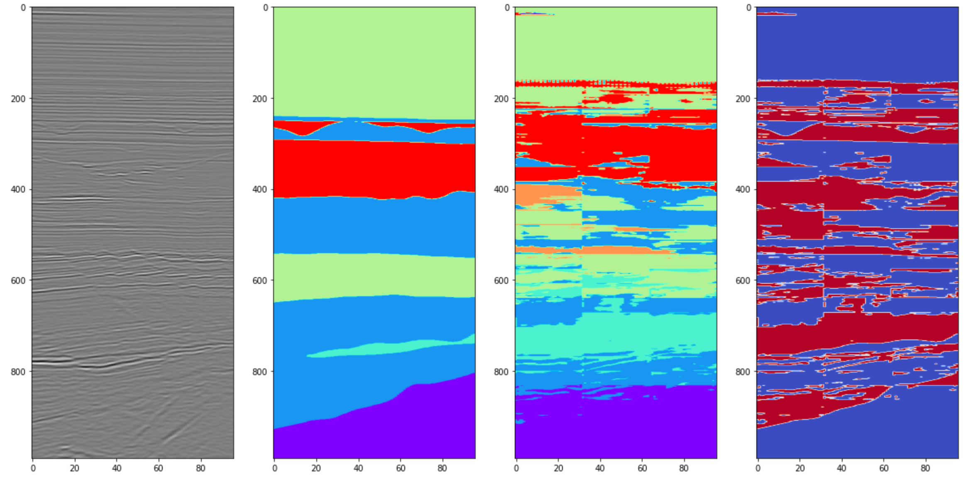
Unet: RMS
Accuracy: 62% | 16 min end-to-end on 3GPUs
Specifics:
3 GPUs – 5000 boxes, 1 attributes, 30 epochs
Data Loaded +3m = 3m
Data Augmented +1m = 4m
Data Prep & Model Compile +3m = 7m
Model Trained +7m = 14m
Predictions Generated +2m = 16m

Slide 14
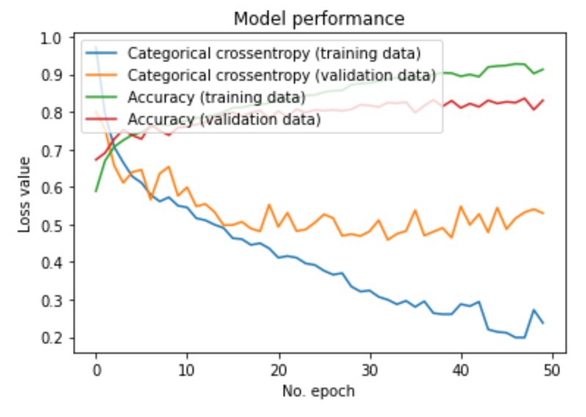
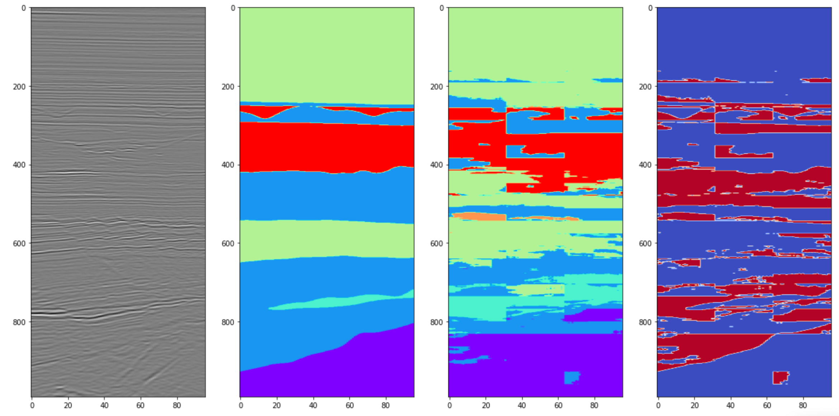
Unet: RMS + learning
Accuracy: 71% | 28 min end-to-end on 3GPUs
Specifics:
3 GPUs – 8000 boxes, 1 attributes, 50 epochs
Data Loaded +3m = 6m
Data Prep & Model Compile +8m = 14m
Model Trained +12m = 26m
Predictions Generated +2m = 28m

Slide 15
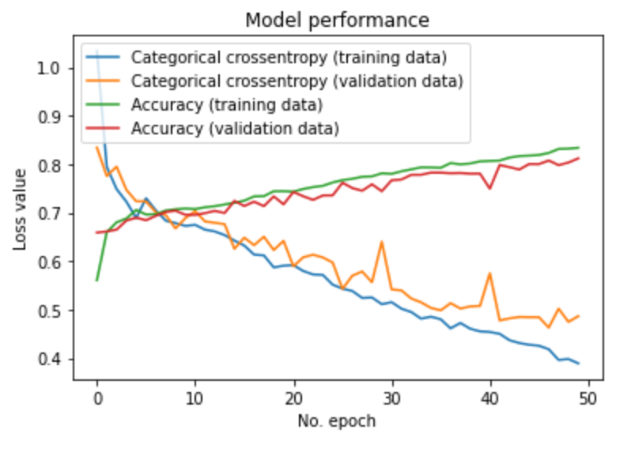
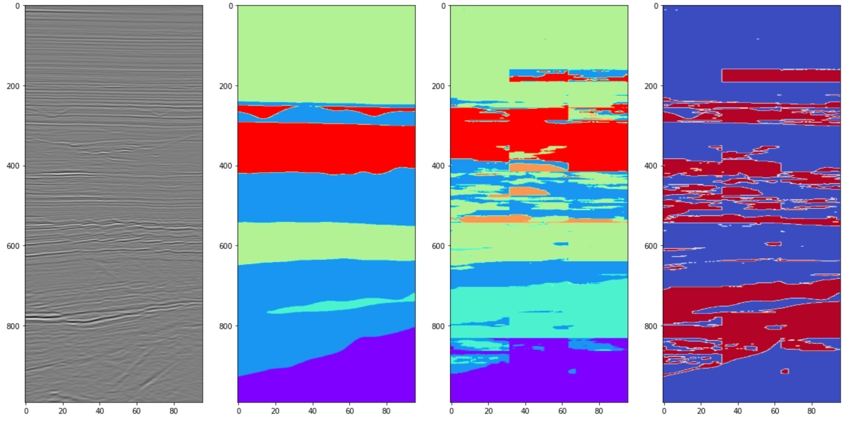
Unet: RMS + learning + transformation
Accuracy: 68.6% | 27 min end-to-end on 3GPUs
Specifics:
3 GPUs – 8000(aug) boxes, 1 attributes, 50 epochs
Data Loaded +3m = 3m
Data Augmented +2m = 5m
Data Prep & Model Compile +8m = 13m
Model Trained +12m = 25m
Predictions Generated +2m = 27m

Slide 16
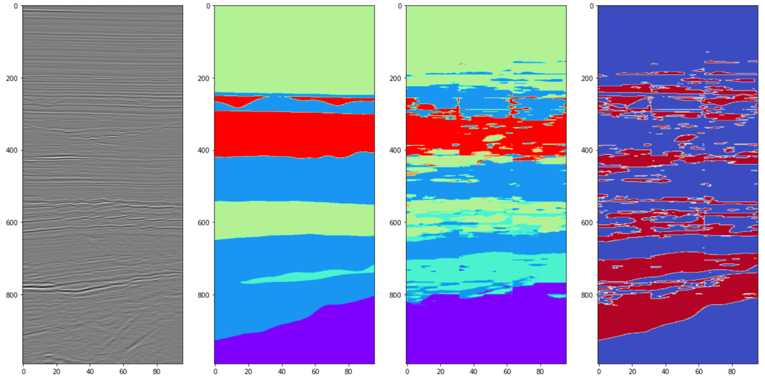
Unet: Semblance + learning + transformation
Accuracy: 68.3% | 27 min end-to-end on 3GPUs
Specifics:
3 GPUs – 8000(aug) boxes, 1 attributes, 50 epochs
Data Loaded +3m = 3m
Data Augmented +2m = 5m
Data Prep & Model Compile +8m = 13m
Model Trained +12m = 25m
Predictions Generated +2m = 27m

Slide 17
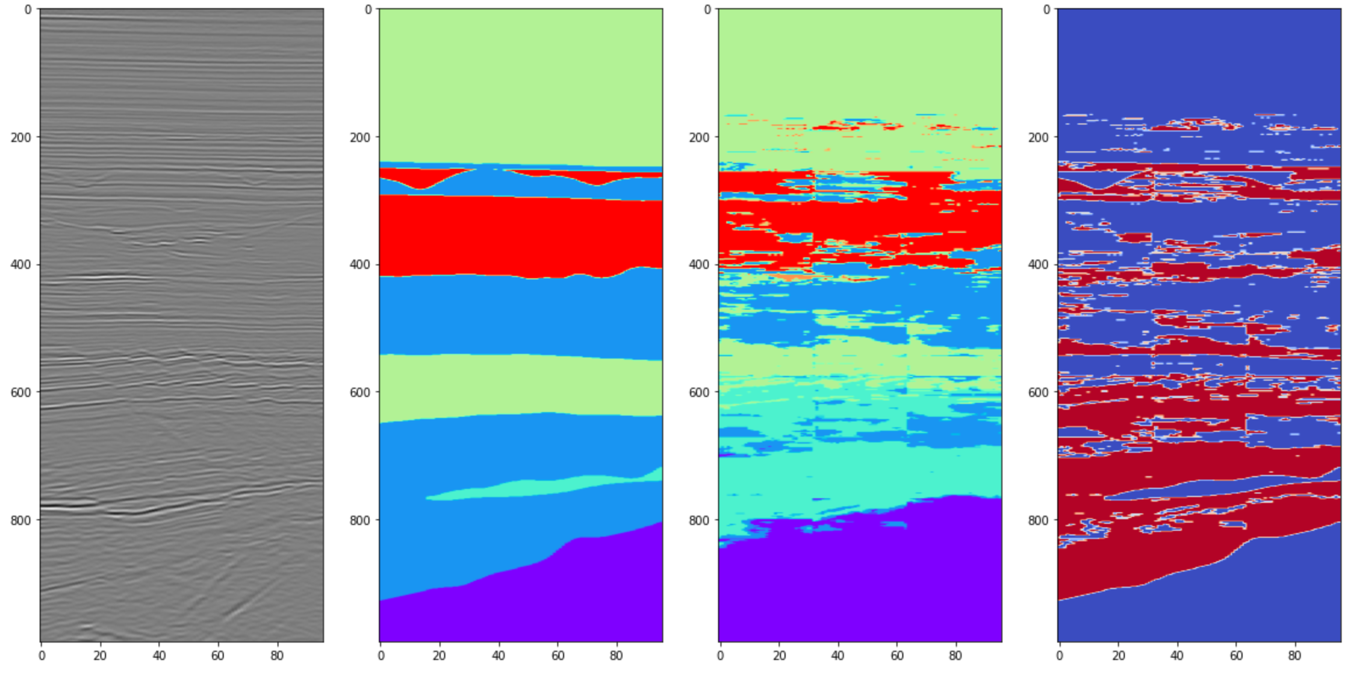
Unet: Inst Ph + learning + transformation
Accuracy: 62.3% | 27 min end-to-end on 3GPUs
Specifics:
3 GPUs – 8000(aug) boxes, 1 attributes, 50 epochs
Data Loaded +3m = 3m
Data Augmented +2m = 5m
Data Prep & Model Compile +8m = 13m
Model Trained +12m = 25m
Predictions Generated +2m = 27m

Slide 18
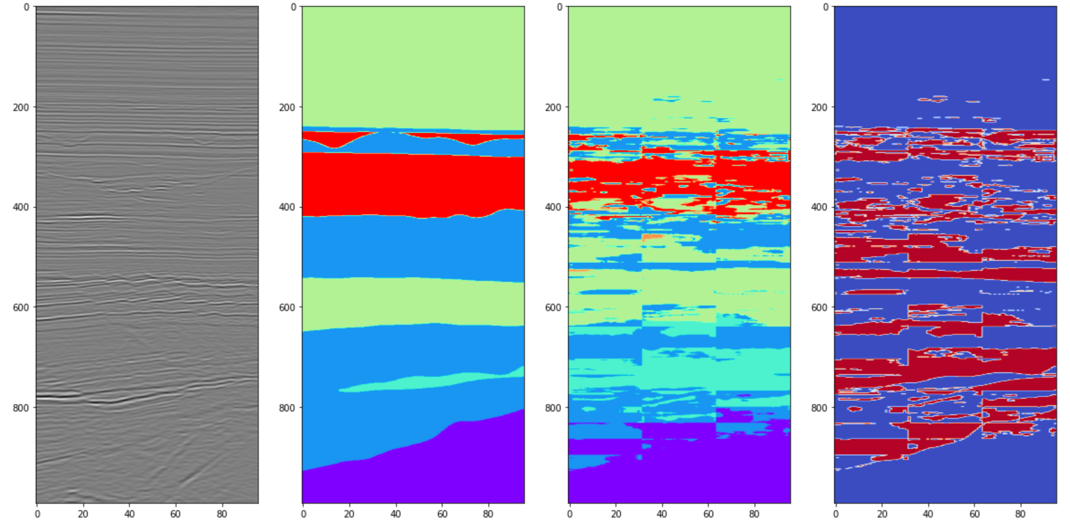
Unet: RMS, Semblance, Inst Ph + Learning + Transformation
Accuracy: 71% | ~30 min end-to-end on 3GPUs
Specifics:
3 GPUs – 5000(aug) boxes, 3 attributes, 50 epochs

Slide 19
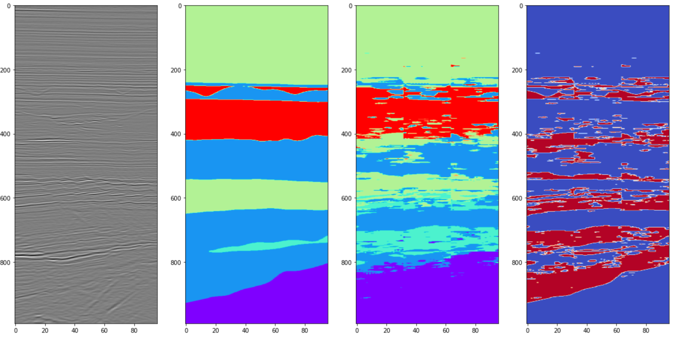
Unet: No Attr + Learning + Transformation
Accuracy: 70.5% | ~26 min end-to-end on 3GPUs
Specifics:
3 GPUs – 8000(aug) boxes, 0 attributes, 50 epochs
Data Loaded +3m = 3m
Data Augmented +2m = 5m
Data Prep & Model Compile +5m = 10m
Model Trained +14m = 24m
Predictions Generated +2m = 26m

Slide 20
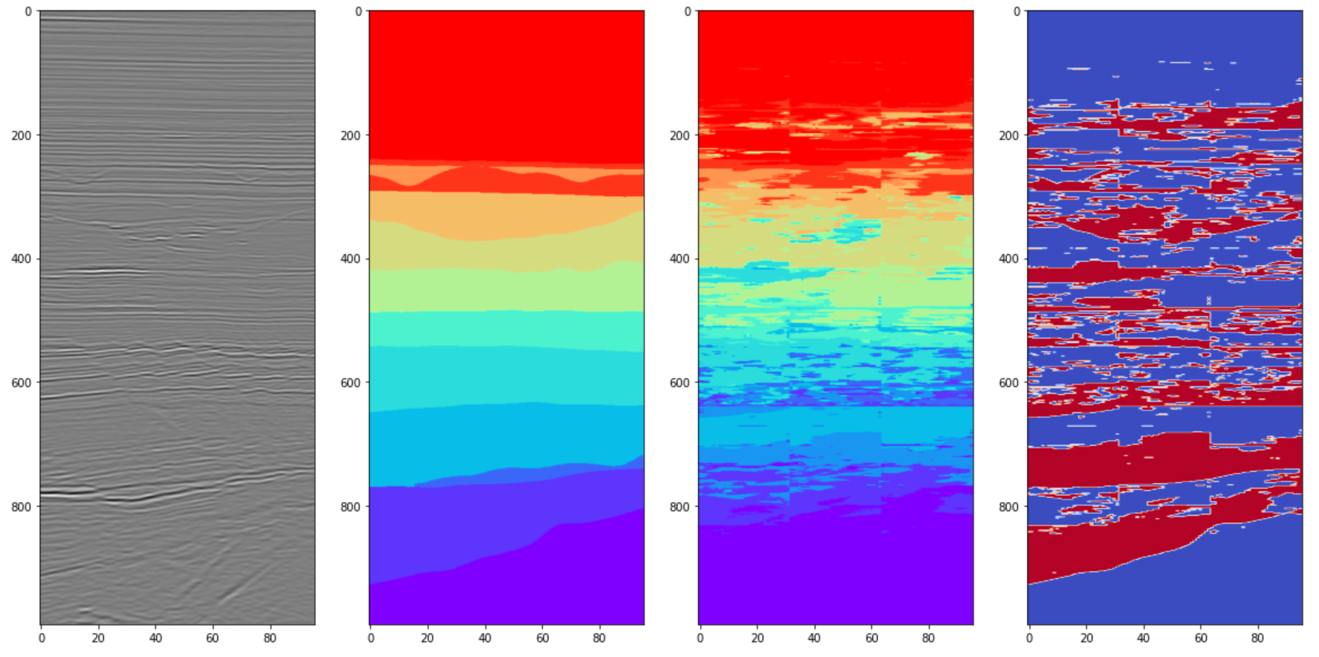
Unet: Feasibility on 16-facies data set
Accuracy: 62% | ~30 min end-to-end on 3GPUs
Specifics:
3 GPUs – 8000(aug) boxes, 0 attributes, 50 epochs

Slide 21
LESSONS LEARNED
Team Advanced By
Connection to and learning from diverse mentors
Timely and frequent communication with team members
Collaboration and development platform provided by Xrathus
Challenges Experienced
Having to learn and use optimal coding practices on the fly
End-to-end setup of Nvidia coding environment
Needing more RAM

